Slide 1
POWER BI PROJECT PRESENTATION
Dashboard Name : HR Data Analysis
Prepared by
Name: Ranjitha.T
Contact: +91 8270007510
Mail : trsan2698@gmail.com

Slide 2
Agenda :
Introduction of Power Bi
What is Power Bi Desktop
What is Power Query Editor
Get Data & Cleaning process
Data Visualization
Using Multiple charts for report
Final step Dashboard creation

Slide 3

POWER BI :
Power Bi is Business Intelligence tool introduced by Microsoft in 2011.
It helps us to Import data from various data sources and turn it into a valuable reports and we can share the reports with anyone easily.

Slide 4
What is Power bi desktop?
Power Bi Desktop is an open-source Application developed and designed by Microsoft
It allows users to connect, to transform and visualize your data with ease
Power Bi Desktop lets users build visuals and collection of visuals that can be shared as a reports with your colleagues or your clients in your organization.
What is power query editor ?
Power query is a BI tools designed by Microsoft for Excel.
Power query allows you to import data from various data sources and will enable you to clean, transform and reshape your data as per the requirements.
Power query allows you to write your query once and then run it with a simple refresh.

Slide 5
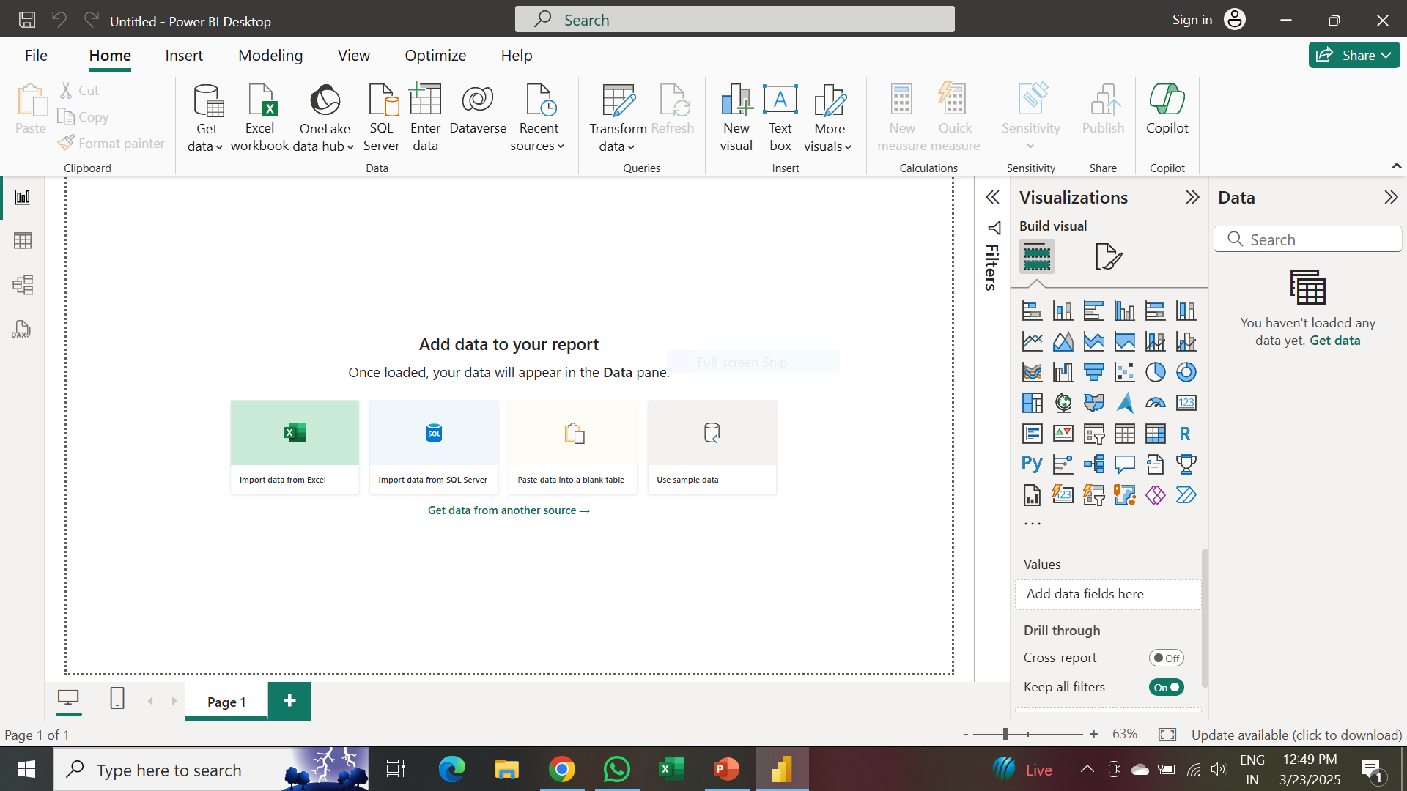
Get data & cleaning process :
Get data :
In Power BI, "Get Data" is the starting point for bringing in data from different sources into your Power BI project.
Cleaning process :
Check for and remove duplicate and Null values.
We can Handle missing values, Fixing datatype, creating New columns etc.

Slide 6
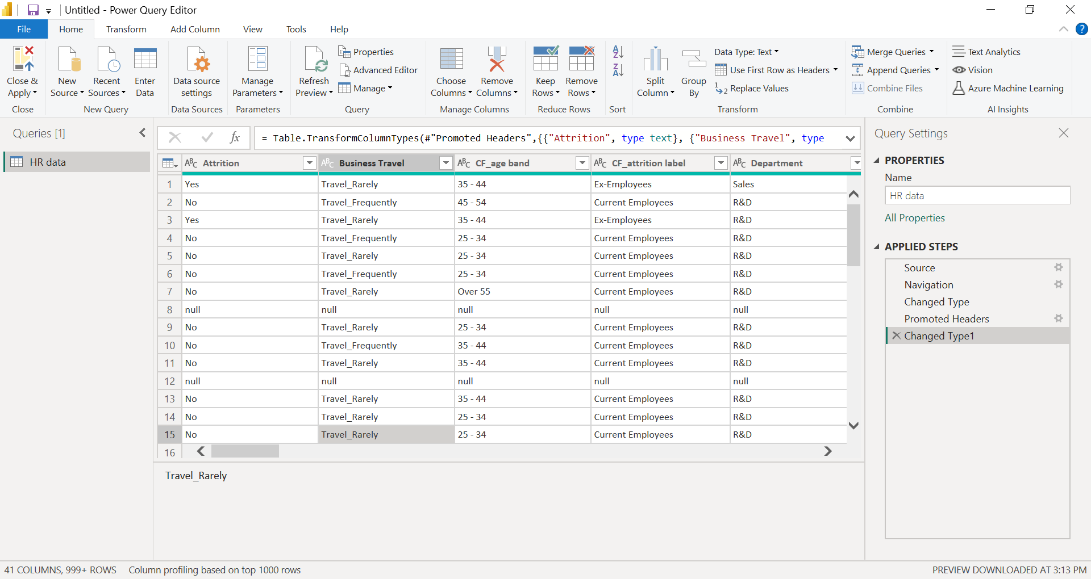
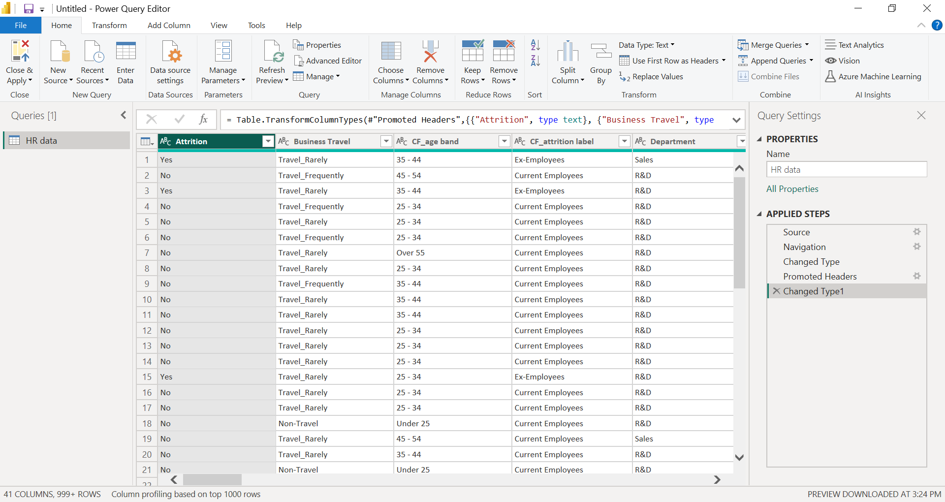
Transform data to power query :
In this HR Datasheet, we have some NULL values and need to remove the fields from the data. We can add new column if required.
DATA CLEANING PROCESS :
After completing all the cleaning process, we need Click “Close and Apply”.
We can view all the Correction which we have made in power query Editor it will be available in “Applied Steps”

Slide 7
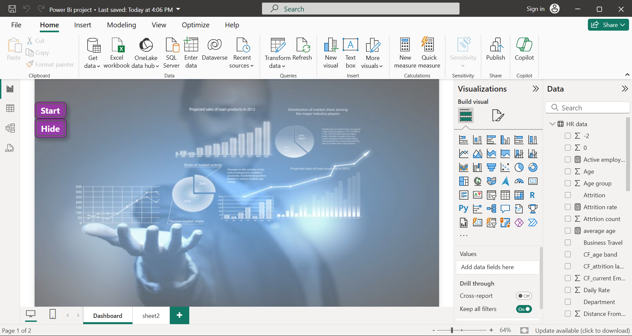
Canvas bg settings :
we can able to set the Back ground color or image to our report page, that is called canvas. Here I have chosen analytical image as Background.

Slide 8
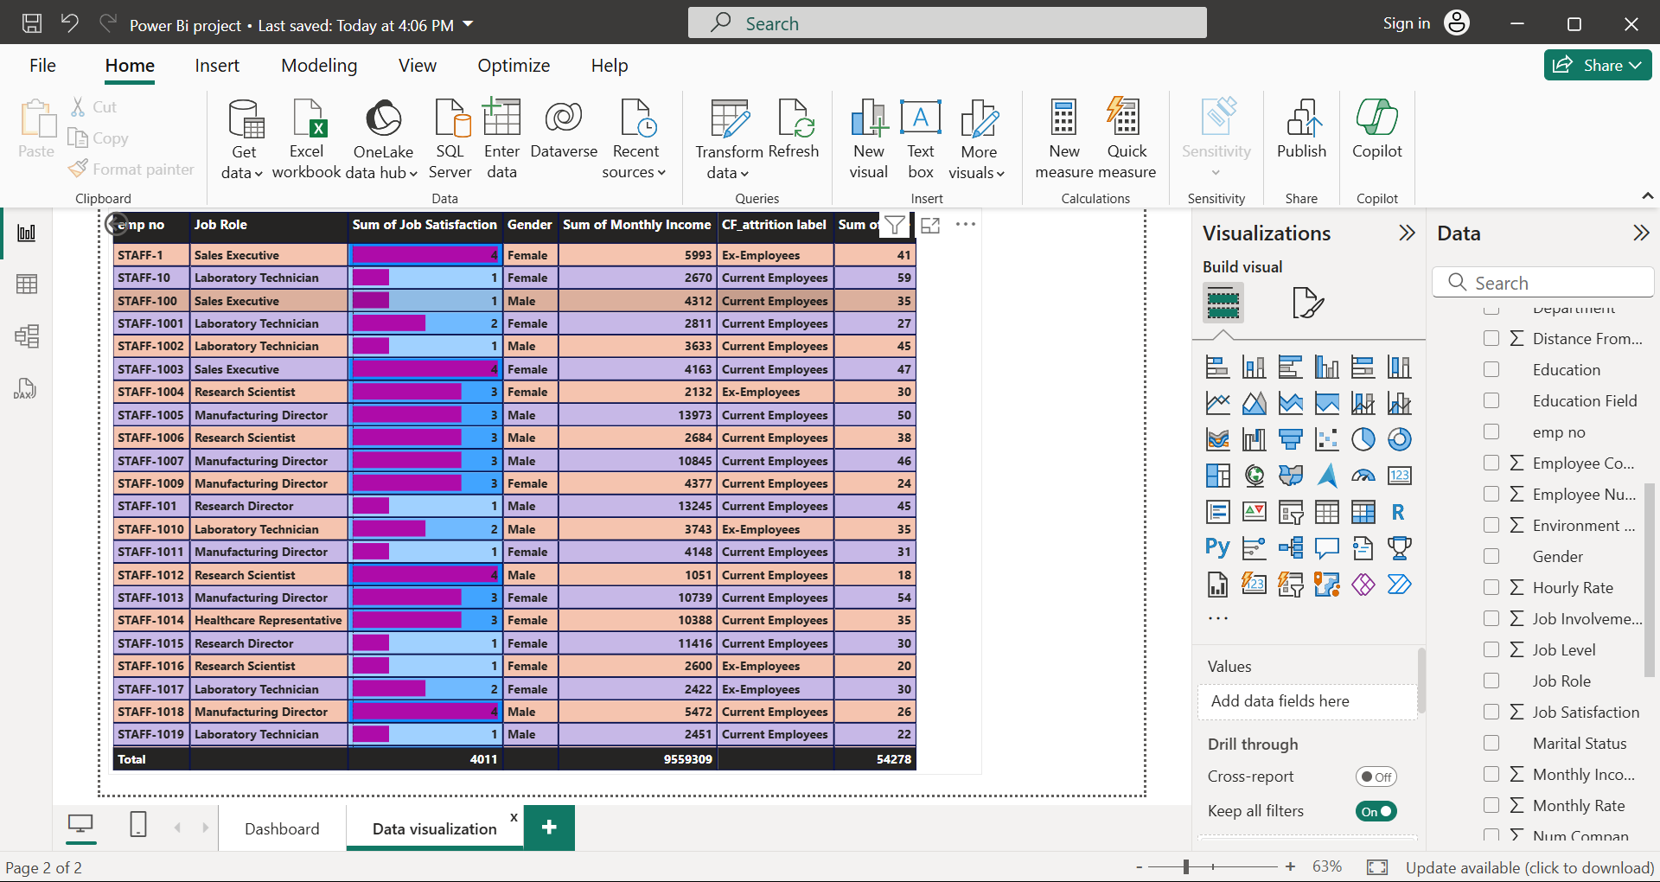
Data Visualization :
In Data Visualization part, we can add varieties of Charts, Maps and using other elements like slicers, Buttons and drill through options to make our Report more effectively.
Data Visualization

Slide 9
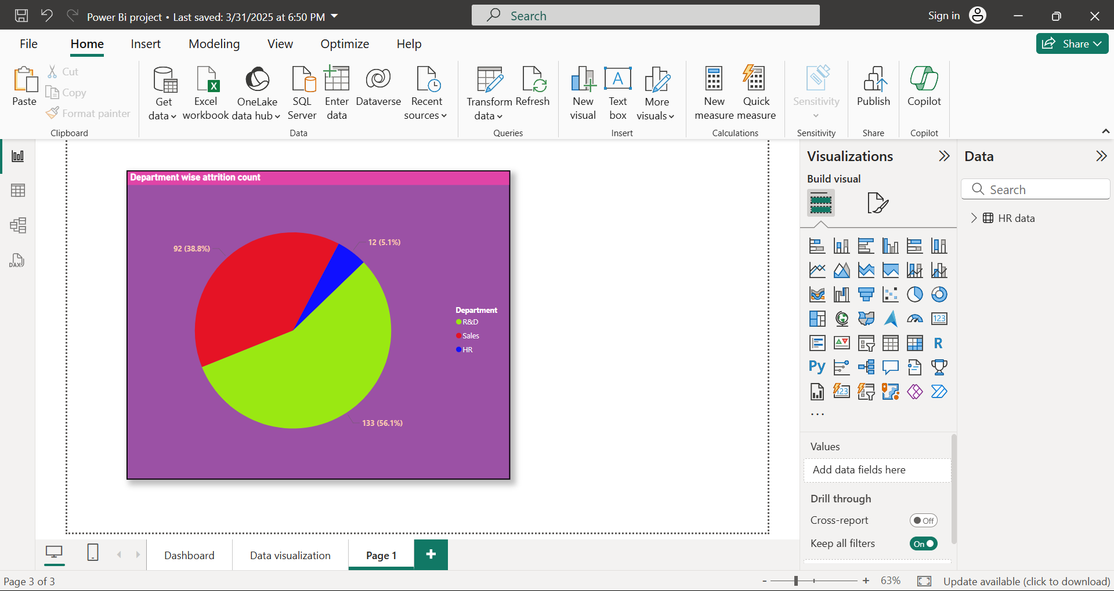
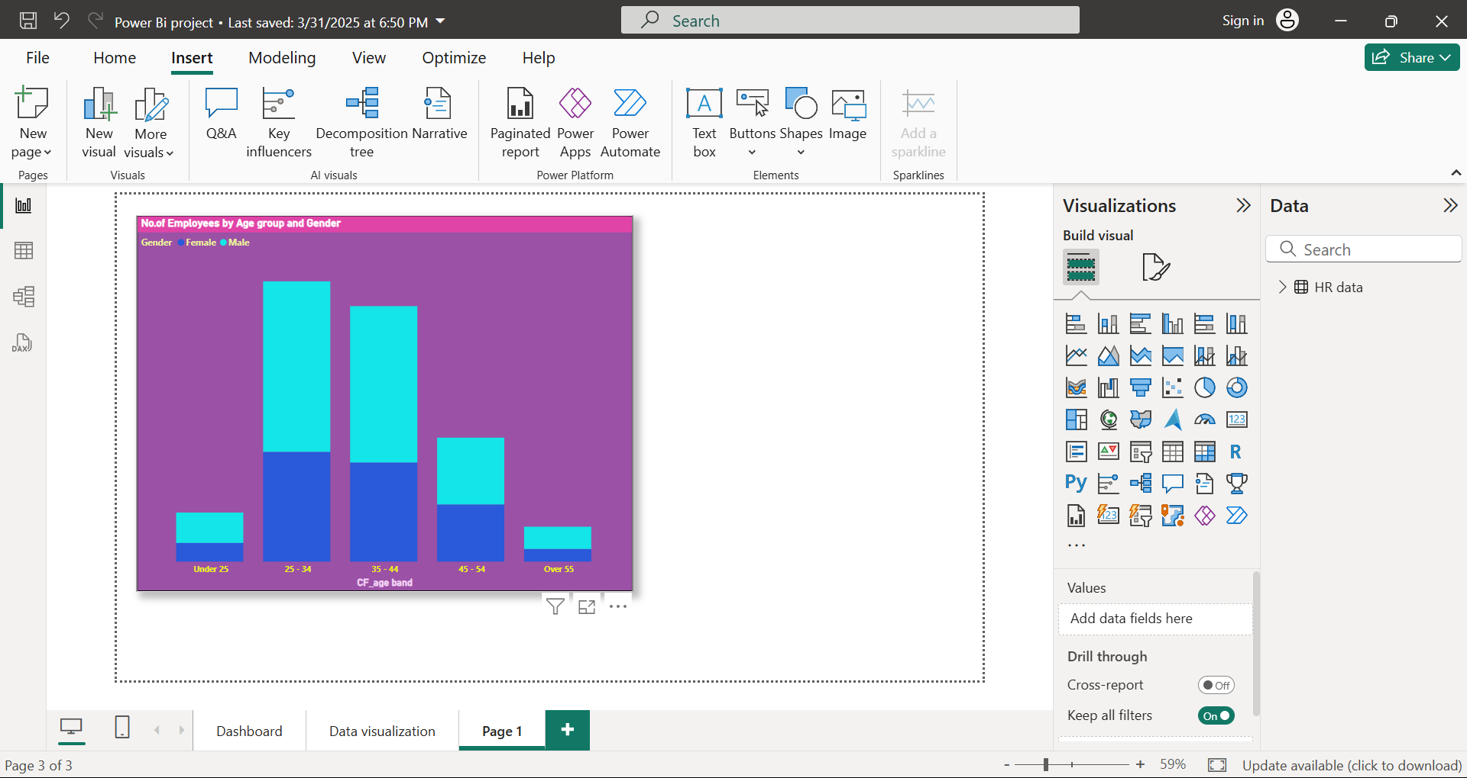
PIE CHART CREATION
Here We have created a Pie chart to illustrates the distribution of employee attrition across different departments. Each slice represents the count of employees who have left the organization from that specific department. Like,
R&D
Sales
HR
Stacked Bar Chart
In this Dashboard we have created the Age group and Gender wise attrition count Using “Stacked Bar Chart”.
There are five categories of Age Group people is available
Under -25
25-34
35-44
45-54
Over 55

Slide 10
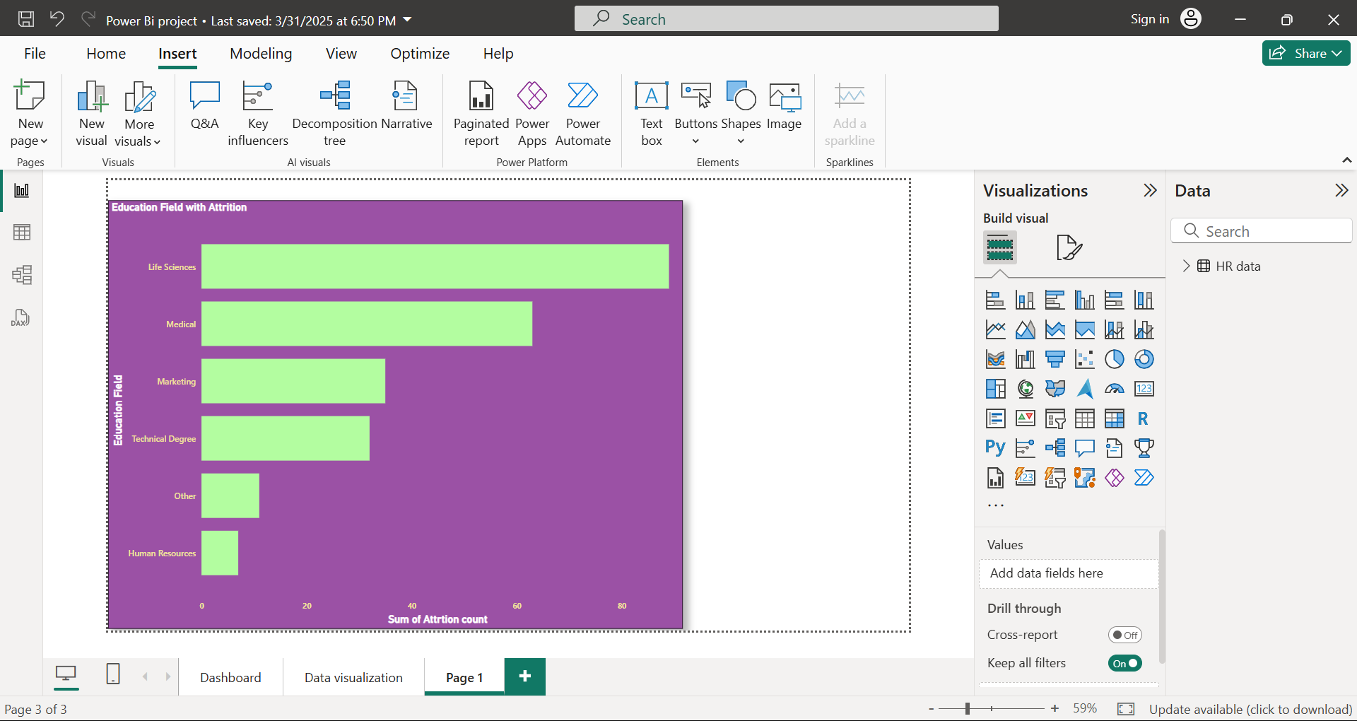
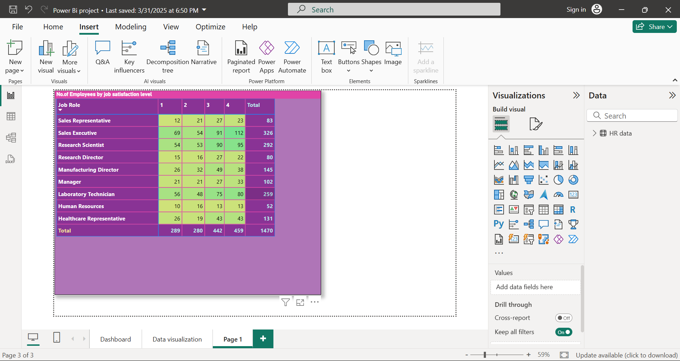
Clustered Bar Chart
We have using Clustered Bar chart to categorize the attrition count by Using Educational field
Matrix :
In this Dashboard we have Finding Employee job satisfaction level Using Matrix

Slide 11
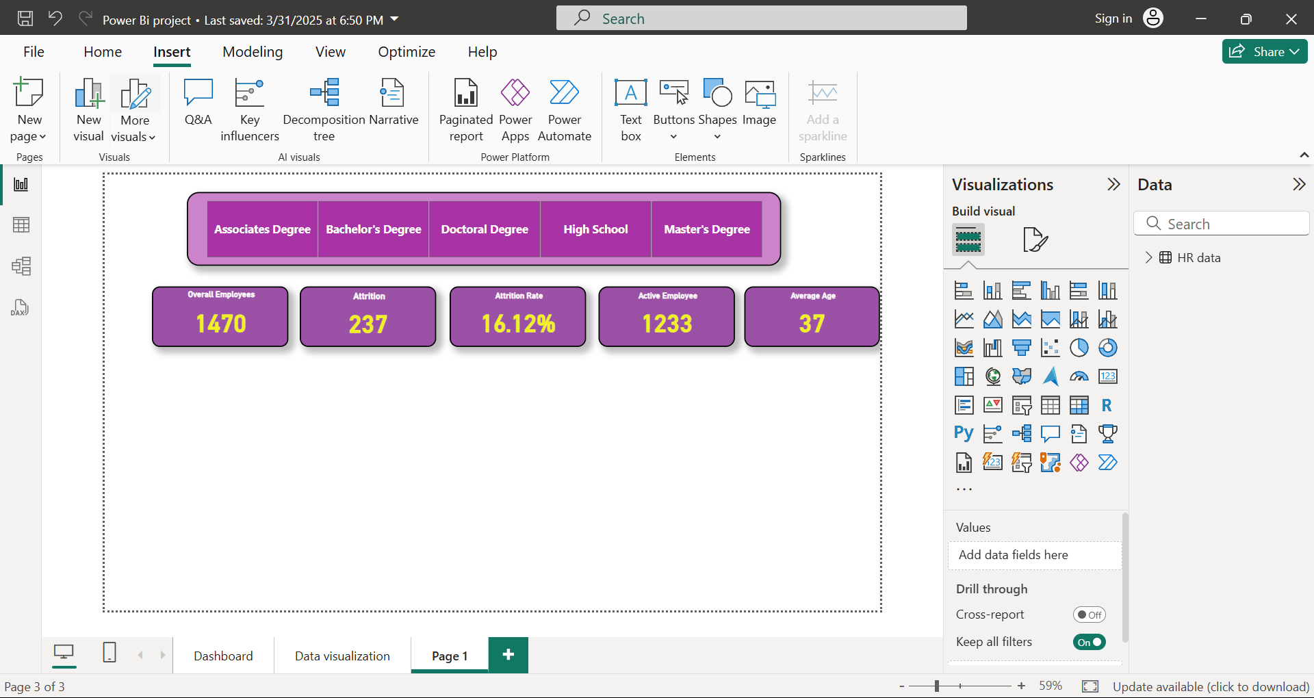
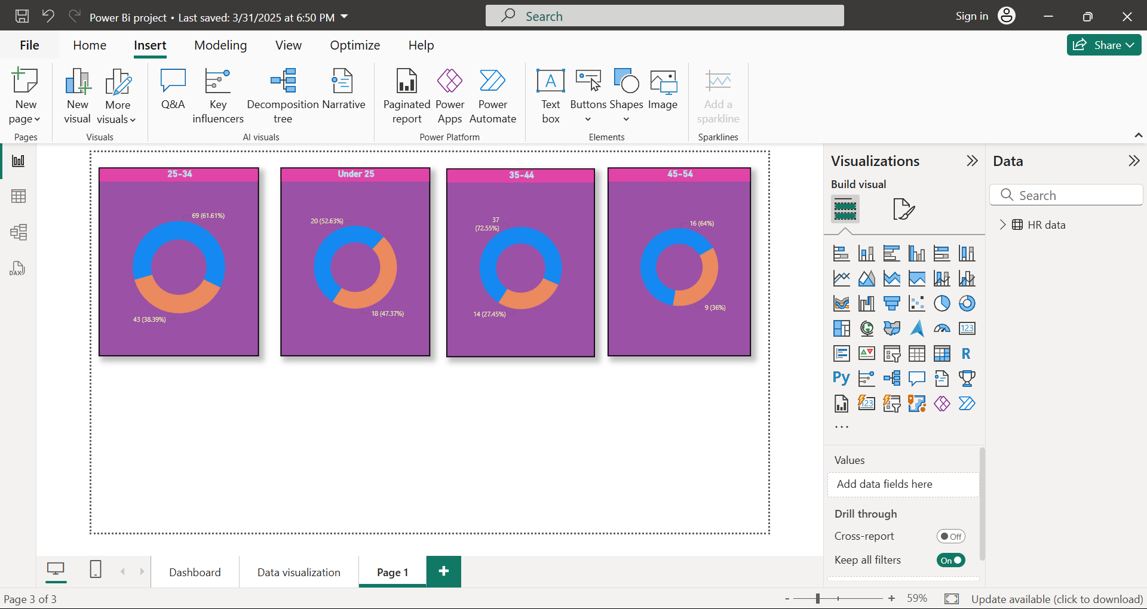
Slicers and Cards:
Here we added some cards to find the Total no.of attritions and active Employees.
It helps us to find the value Easily.
Donut Chart:
Similar with pie chart, in this chart we can find the Employee attrition count in age groupwise separately

Slide 12
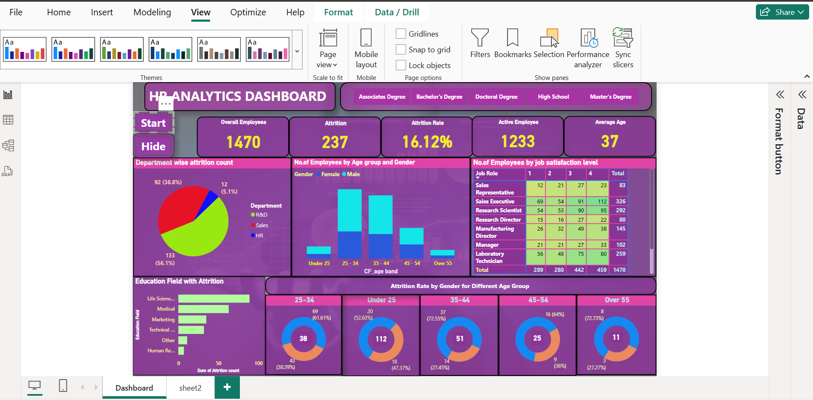
Dashboard full report:
Here I created a Dashboard, based on the attrition count details of the Employees for HR analytical purpose

Slide 13


